Slide 1

History Heroes
Term 3
Week 6

Slide 2
1. Compare and contrast the messages of Sources 1 and 2. (4 marks) What are the four things you must do for this question?

Slide 3
1. Compare and contrast the messages of Sources 1 and 2. (4 marks) What are the four things you must do for this question?
State the message of source 1
State the message of source 2
Outline what is similar about the message of the sources
Outline what is different about the message of the sources

Slide 4
2. Evaluate the usefulness, in terms of strengths and weaknesses, of Sources 1 and 2 in relation to crises in Germany in 1923. (5 marks) What are the five things you must do for this question?

Slide 5
2. Evaluate the usefulness, in terms of strengths and weaknesses, of Sources 1 and 2 in relation to crises in Germany in 1923. (5 marks) What are the five things you must do for this question?
Provide examples of useful information source 1 in relation to crises in Germany in 1923
Provide examples of not useful information source 1 in relation to crises in Germany in 1923
Provide examples of useful information source 2 in relation to crises in Germany in 1923
Provide examples of not useful information source 2 in relation to crises in Germany in 1923
Evaluate the usefulness of the sources as evidence about the question.

Slide 6
3. Explain the historical context of Source 3. Include the relevant events, people and ideas depicted or represented in the source. (4 marks) What are the four things you must do for this question?

Slide 7
3. Explain the historical context of Source 3. Include the relevant events, people and ideas depicted or represented in the source. (4 marks) What are the four things you must do for this question?
What and when
Cause
Effect
Significance

Slide 8
4. Identify and account for the authors’ perspectives in Sources 3 and 4 in relation to German foreign policy in the 1920s. (6 marks) Where do the six marks come from for this question?

Slide 9
4. Identify and account for the authors’ perspectives in Sources 3 and 4 in relation to German foreign policy in the 1920s. (6 marks) Where do the six marks come from for this question?
Identify the author and their perspective in source 3.
Account for the author’s perspective in source 3 (give a reason - bias, motives, time, place, purpose) (2 marks)
Identify the author and perspective in source 4.
Account for the author’s perspective in source 4 (give a reason - bias, motives, time, place, purpose) (2 marks)

Slide 10
5. Evaluate the extent to which the four sources give an accurate insight into attitudes regarding changes in domestic economic policies during the period of study. (6 marks) Where do each of the six marks for this question come from?

Slide 11
5. Evaluate the extent to which the four sources give an accurate insight into attitudes regarding changes in domestic economic policies during the period of study. (6 marks) Where do each of the six marks for this question come from?
Articulate the different attitudes of change that are shown in all four sources (2 marks).
Identify attitudes that have been omitted in each of the sources (1 mark).
Evaluate the extent to which the sources reflect the different attitudes regarding changes in domestic economic policies during the period of study (3 marks).

Slide 12
6. What does Volksgemeinschaft mean? (1 mark)

Slide 13
6. What does Volksgemeinschaft mean? (1 mark)
The People’s Community

Slide 14
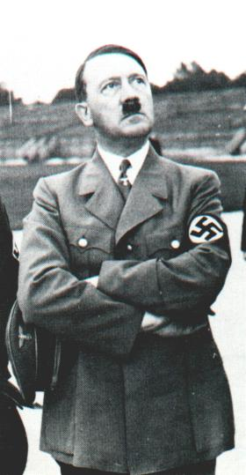
How did you go? /26

Slide 15

Source of the week

Slide 16
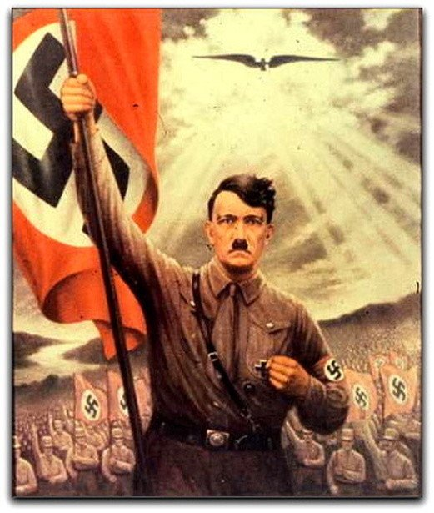
Adolf Hitler, Propaganda, Poster, NSDAP

